Slide 1
Notes:
Good morning and welcome to this course information and computation.
This course is part of the minor in quantum information. You may wonder why bother learning about information and computation in general when you want to learn about quantum information and quantum computation?
Well, it turns out the general picture mattes quite a bit, we are amazed by the power of quantum, but only because we compare it to the prequantum world. Our goal in this course is to learn all the necessary tools of classical computation and information such that you are able to appreciate the power of quantum information and quantum computation. But also, such that you can appreciate when quantum is of no use. It turns out, that this is in fact the most common situation. Quantum, helps inmensely with a small but selected set of problems.
A second reason to learn about this topics is because it is mind bogling, we will learn about the giants that discovered the rules and limitations of the information world that we know today.

Slide 2
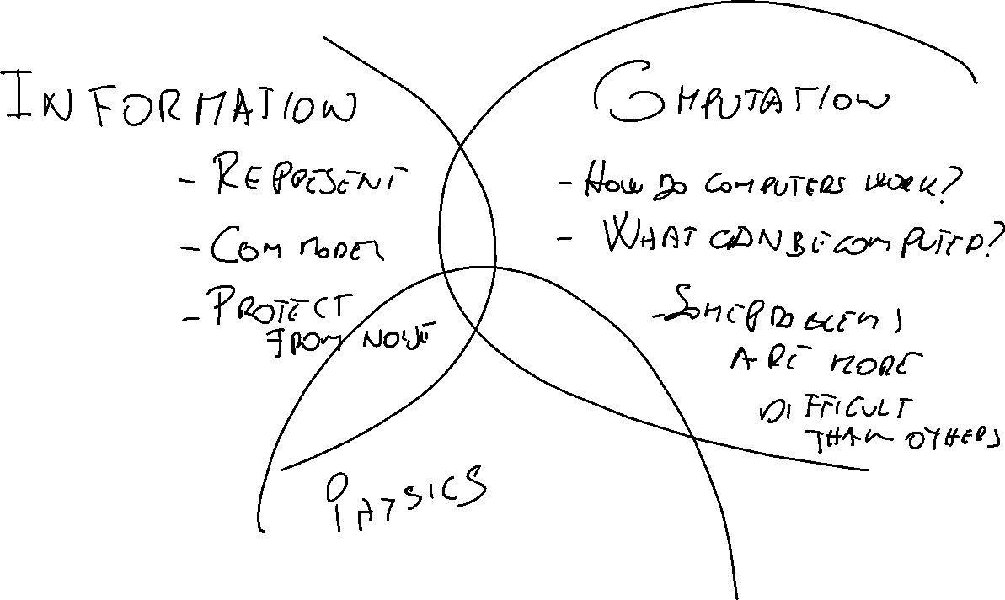
Notes:
The questions that we aim to explore are broad, let us take a birds eye view at the full picture of the course. We will explore three related topics, information, computation and the physics of information and computation. You will have Carmina and myself teaching computation, you will have myself for the information lectures and Ryoichi will take care of the physics part. Let us now dig a little bit deeper in the material.
First information.
We will ask what is information? Can it be quantified? An example that will lead our discussion will be that of the outcome of a coin. Imagine that I tell you the outcome of a coin, how much information you learn? Now, let’s imagine that the coin is loaded such that it almost always lands on heads, do you learn the same if I tell you that it landed heads than if I tell you that it landed tails? Or, let’s imagine that you have two coordinated coins, either both land on tails or both land on heads. If I you have one of the coins, and it lands heads, how much information you learn if I tell you that the other also did land heads? As you see, I am hinting that the amount of information is related to how unexpected an outcome is. But is this way of quantifying information meaningful? Does it carry an operational value? We will explore how this is the case.
Then, we will move to communications and learn about noise. Can we communicate reliably in the presence of noise? Suppose that you want to tell me the value of a coin. You could encode it in a binary variable, 0 for heads and 1 for tails. Now, let us assume that you send me the binary variable in some physical carrier for instance a voltage, but the communications line is noisy and with some probability it will distort the wave shape such that we don’t know if we sent a 0 or a 1. What can we do to communicate reliably over such a channel? Well, we could repeat sending the message. However, if originally the probability of getting at least one symbol through the channel was 1-p, now it will be 1-p^2, better but still not 1 also, now we are sending information at half the speed as before. If we want to get arbitrarily close to 1, we will have the paradox tha twe are not sending any information at all! An important topic of study will be the techniques tha allow to transmit reliably in the presence of noise.
The second main topic will be computation:
What does it mean to compute? Let us suppose that you want to build a machine that adds numbers, how would you do it? Ok, so maybe I would decompose the numbers in strings of bits and would translate the rules of addition into Boolean logic and go from there. Note that for all inputs, our machine if it is well built, at some point it will produce an output and then end. However, there are algorithms that never end, imagine a for loop without end condition. Now let’s suppose we are bothered by these annoying algorithms that do not end on some input. We want to build a machine that takes as input an algorithm and some input, and out machine will outputs yes, if the algorithm ends and no if the algorithm does not end. How could we build such a machine? Well, indeed, it turns out that such a machine does not exist. That is, there are some problems for which no solution exist. In fact, most problems are of this type!
Then, even if we restrict our attention to computable problems. It turns out that not all problems that are computable can be computed in practice. We will look at how the number of computation steps increases as the size of the input increases. For instance, in the sum problem, we will care at how the number of computation steps increases with the length of the input numbers. This number, we will find out that increases linearly with the size of the input, which means that we can sum very long numbers. But other problems require a number of steps that grows quadratically or even exponentially with the size of the input. This growth limits what we can compute in practice. It also turns out, that how this number of steps grows depends on weather the computer operates according to classical or quantum mechanics!
The final ingredient in the course will be physics. How can we implement the ideal models of computation and information transmission that we discuss with real physical devices?
Something about it from bit or perhaps better Church-Turing

Slide 3
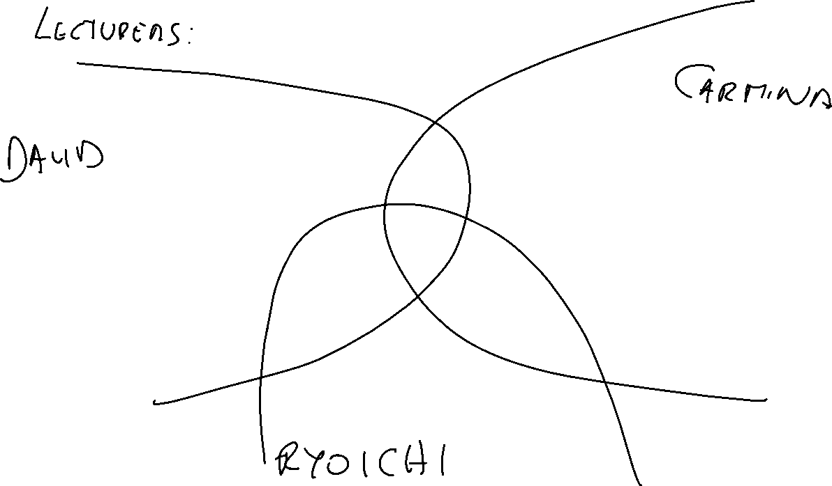

Slide 4
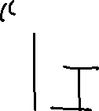








Slide 5




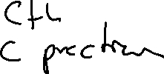





Notes:
Let us now quickly describe the structure of the course.
We will have two long four hour sessions every week, Wednesdays and Fridays. It is a very intense course, we will make our best to keep your attention up with small questions and different activities during each session. Also, in order to keep everyone engaged we will have a weekly minitest on Wednesdays, beginning today… no, just joking. Beginning next Wednesday. We will have then 4 minitests testing the material from the previous week. The final grade will be the average of the four minitests. If the average is below 6.0 or if you want to improve your grade there will be a final exam on XXX.
Topic-wise: The first three Wednesdays we will dedicate to information theory and the fourth to complexity theory. The first three Fridays will be dedicated to our introduction to computation while the fourth will be our short overview of the physical implementation of computation devices.

Slide 6











